Slide 1
Chapter 8: Memory-Management Strategies

Slide 2
Chapter 8: Memory Management Strategies
Background
Swapping
Contiguous鄰近的 Memory Allocation
Paging
Structure of the Page Table
Segmentation
Example: The Intel Pentium
Notes:
Swapping : 記憶體裡面已經有proc 可能滿了 還想把另個proc般入 就要搬出mem的 搬進新的proc Contig Mem All:分配mem給proc時 優先分配連續的空間 但ch9介紹virtual mem技術 就可以不連在一起 Paging : 分配連續的空間 不同的連續空間之間可能有Hole 零碎的Hole空閒的空間 加起來總空間可能可以在塞一個新的proc但因為不連續所以沒辦法 因為程式一定要分配一起的大空間 所以Paging: 程式接成固定大小的Frame 記憶體也切成固定大小的Page 一個page塞一個frame 程式執行的時候要找在哪個page 所以要有對照表 page table 第幾個f放在第幾個p Segement:但是切成固定大小的frame 比較沒有logic概念 也就是程式有分不同的subroutine procedure 可能大小分別不同 所以依照不同的logic區塊接分不同大小 就是segement 大小可以不一定

Slide 3
Objectives
To provide a detailed description of various ways of organizing memory hardware
To discuss various memory-management techniques, including paging and segmentation
To provide a detailed description of the Intel Pentium, which supports both pure segmentation and segmentation with paging

Slide 4
Background
Program must be brought (from disk) into memory and placed within a process for it to be run
Main memory and registers are only storage CPU can access directly
Register access in one CPU clock (or less)
Main memory can take many cycles
Cache sits between main memory and CPU registers
Protection of memory is required to ensure correct operation 保護其他proc不能寫到自己的
程式沒授權不能寫OS在用的記憶體

Slide 5
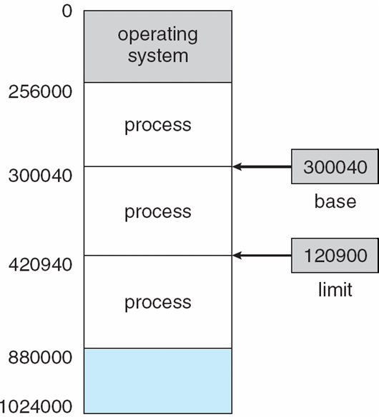
Base and Limit Registers
針對每個procc會去用b~l 作保護 L是大小 所以30040()+120900=420940 可用範圍 A pair of base and limit registers define the logical address space

Slide 6
Binding of Instructions and Data to Memory
Address binding of instructions and data to memory addresses can happen at three different stages
三個決定的時間點
Compile time: If memory location known a priori, 叫absolute code can be generated; must recompile code if starting location changes 所以通常不要用
Load time: Must generate relocatable code if memory location is not known at compile time 相對位置 但開始執行決定後就不動了
Execution time: Binding delayed until run time if the process can be moved during its execution 執行中也可以移動 from one memory segment to another. Need hardware support for address maps (e.g., base and limit registers)
Notes:
綁定instructions and data 在 memory 的addresses 第一點 寫高階語言>compiler 組合語言>assembler 有個指令org可以指定開始位置

Slide 7
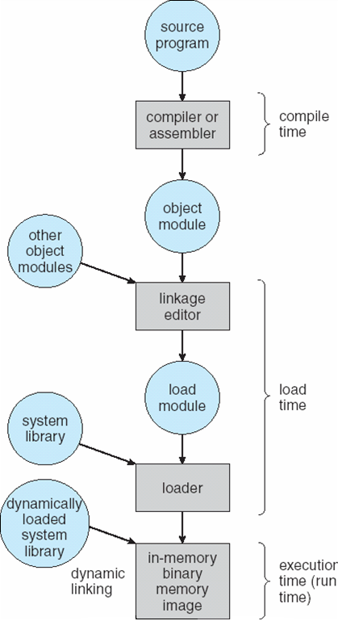
Multistep Processing of a User Program
Notes:
這三個對應前面的三個 comp:絕對 load:相對 exe:動態 module:模組

Slide 8
Logical vs. Physical Address Space
The concept of a logical address space that is bound to a separate physical address space is central to proper memory management
Logical address – generated by the CPU; also referred to as virtual address
Physical address – address seen by the memory unit真正的mem位址
Logical and physical addresses are the same in compile-time and load-time address-binding schemes; logical (virtual) and physical addresses differ in execution-time address-binding scheme
Notes:
CPU也要產生一些addr去抓程式的位置 > Logical Addr compile時如果不使用絕對位置 起始位置通常給0 然後假設程式抓中間的資料距離0 2000 就是虛擬位置 程式實際執行放在mem的10000 那時寄資料位置就是10000+2000 如果用絕對位置 則logic addr 和phy addr會相同

Slide 9
Memory-Management Unit (MMU)
Hardware device that maps virtual to physical address mmu功用:vir轉phy
In MMU scheme, the value in the relocation register is added to every address generated by a user process at the time it is sent to memory
^^相對位址加上初始位址才是mem的位址
The user program deals with logical addresses; it never sees the real physical addresses

Slide 10
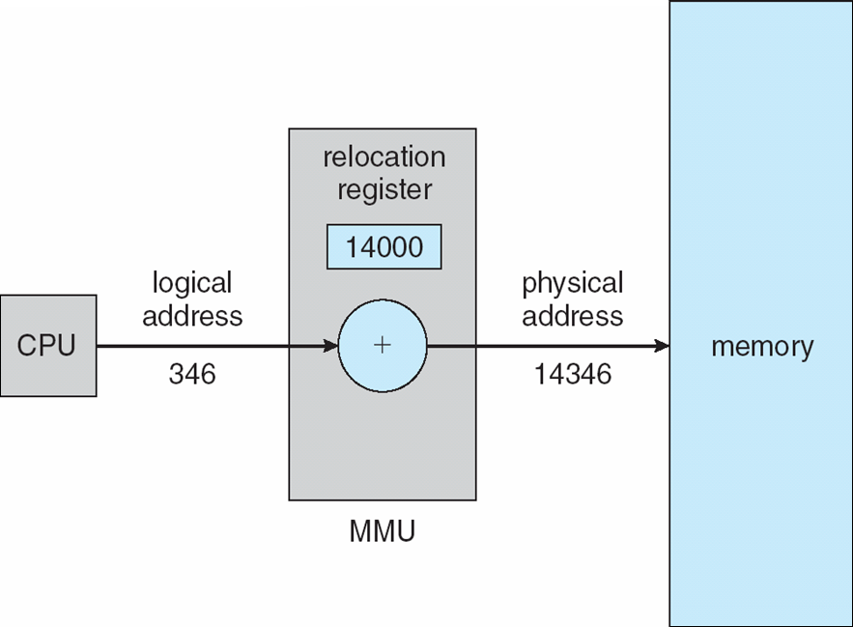
Dynamic relocation using a relocation register
Notes:
relocation改變位址 Logical address – generated by the CPU; also referred to as virtual address + 初始位址 = phy程式實際在mem位址

Slide 11
Dynamic Loading
Routine is not loaded until it is called
Better memory-space utilization; unused routine is never loaded 簡言之 呼叫到的時候才下載進來
例如錯誤處理相關程式碼 如果整個程式執行過程沒出錯 load近來就有點浪費 不load比較省
Useful when large amounts of code are needed to handle infrequently occurring cases
No special support from the operating system is required
但是會多出請求載入的時間 所以可能會比較慢
IO是最慢的時間
Notes:
每個routine都是滿大一包包起來 呼叫的時候才下載

Slide 12
Dynamic Linking
Linking postponed until execution time
用Small piece of code, stub, used to locate the appropriate memory-resident library routine
Stub replaces itself with the address of the routine, and executes the routine 不用把routine包進程式本身 執行到再切換位址到常住在mem的那包就行
Operating system needed to check if routine is in processes’ memory address
Dynamic linking is particularly useful for libraries
System also known as shared libraries
Notes:
放在硬碟這一包想辦法弄小一點 例如說 程式裡面有1 2 3 4個subroutine 前面Loading是有到真的有呼叫到才下載 Dynamic Linking 是真的有呼叫到才Link Link的動作也延後到貞的執行呼叫到才Link

Slide 13
Swapping
A process can be swapped temporarily out of memory to a backing store, and then brought back into memory for continued execution
Backing store – fast disk large enough to accommodate copies of all memory images for all users; must provide direct access to these memory images
Roll out, roll in – swapping variant used for priority-based scheduling algorithms;
lower-priority process is swapped out so higher-priority process can be loaded and executed
Notes:
proc暫時搬出mem到disk 或反之 搬 mem>disk : swap out 搬 disk>mem: swap in

Slide 14
Swapping
Major part of swap time is transfer time; total transfer time is directly proportional to the amount of memory swapped
Modified versions of swapping are found on many systems (i.e., UNIX, Linux, and Windows)
System maintains a ready queue of ready-to-run processes which have memory images on disk 以利要執行時再搬回來mem

Slide 15
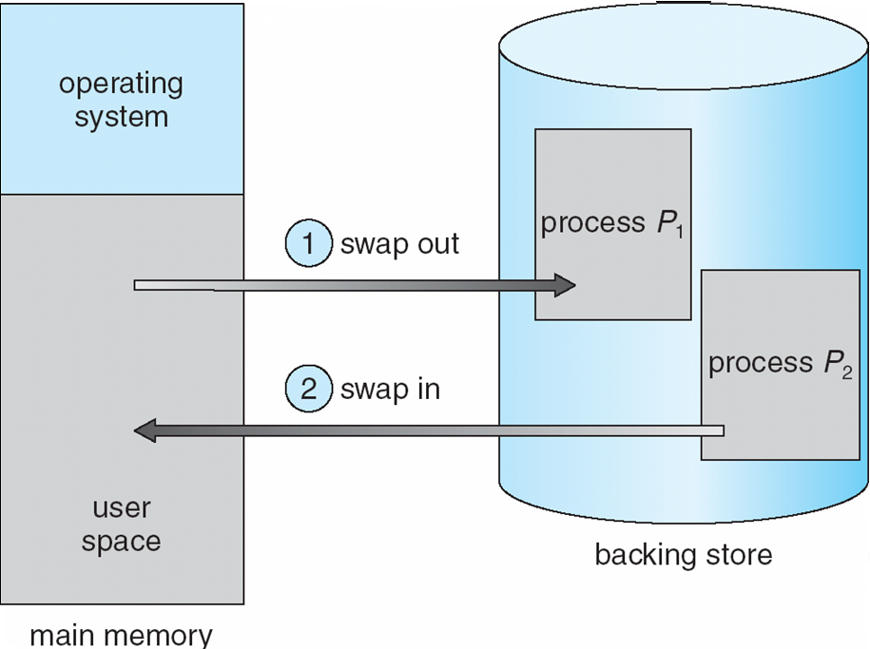
Schematic View of Swapping
Notes:
有 配合前兩張的文字 一目瞭然

Slide 16
Contiguous Allocation連續記憶體
Main memory usually divides into two partitions:
Resident operating system, usually held in low memory with interrupt vector
User processes then held in high memory
Relocation registers used to protect user processes from each other, and from changing operating-system code and data 保護防止互相竄改 和改到OS
Base register contains value of smallest physical address
Limit register contains range of logical addresses – each logical address must be less than the limit register
MMU maps logical address dynamically
Notes:
8-4 start mem切兩塊 比較上面區塊OS用的 下面區塊給使用者

Slide 17

Hardware Support for Relocation and Limit Registers
Notes:
logical address must be less than the limit register 符合的話 加上reloc 變 phy addr = mem else Error

Slide 18
Contiguous Allocation (Cont)
Multiple-partition allocation
Hole洞 – block of available memory; holes of various size are scattered分散 throughout memory 連續的記憶體沒有被使用
When a process arrives, it is allocated memory from a hole large enough to accommodate it
Operating system maintains information about: a) allocated partitions b) free partitions (hole)
OS
OS
OS
OS
process 5
process 5
process 5
process 5
process 9
process 9
process 8
process 10
process 2
process 2
process 2
process 2
Notes:
Multiple-partition allocation > mem先切成兩塊 上給OS 下給user 下方區塊再切成多塊 Multi part 這個圖是說 8先執行結束空出空間 Hole 後面的proc再塞進去
所以執行久了會有很多大大小小的Hole

Slide 19
Dynamic Storage-Allocation Problem
How to satisfy a request of size n from a list of free holes ?
First-fit: Allocate the first hole that is big enough
Best-fit: Allocate the smallest hole that is big enough; must search entire list, unless ordered by size
Produces the smallest leftover hole
Worst-fit: Allocate the largest hole; must also search entire list
Produces the largest leftover殘餘 hole
First-fit and best-fit better than worst-fit in terms of speed and storage utilization
Notes:
ok

Slide 20
Fragmentation
External Fragmentation – total memory space exists to satisfy a request, but it is not contiguous鄰近的
Internal Fragmentation – allocated memory may be slightly larger than requested memory; this size difference is memory internal to a partition, but not being used
Reduce external (非internal，別人不能用!!!) fragmentation by compaction 壓實
Shuffle洗牌 移動 memory contents to place all free memory together in one large block 集合碎片
Compaction is possible only if relocation is dynamic, and is done at execution time
I/O problem - mem區塊處於IO時不能搬動
法一 Latch門閂 job in memory while it is involved in I/O
法二 Do I/O only into OS buffers
Notes:
Hole塞進程式之後 如果有殘餘的小空位 就叫做Fragmentation 如果發現所有的小片段的空間加起來夠再放一個proc 但是因為不連續所以不能放進去 可以用compaction
external是沒被分配給proc的空間 internal是有分配給proc proc本身內部的小空閒空間 !別人不能用 最後一句 OS buffer是說 proc本身要做IO 資料使用OS的buffer做緩衝 而不是proc本身的buffer 這樣子OSbuffer是固定位置範圍 程式就可以被搬來搬去 但是一樣都使用OS buffer沒影響 否則對某個proc的位址做IO 程式被搬走之後 IO對於那個位址就沒辦法繼續了

Slide 21
Paging
Physical address space of a process can be noncontiguous; process is allocated physical memory whenever the latter is available
Paging avoids external fragmentation and the needs for compaction.
Divide physical memory into fixed-sized blocks called frames (size is power of 2, between 512 - 8,192 bytes)
Divide logical memory into blocks of same size called pages
Keep track of all free frames 要分配so要記那些空閒
To run a program of size n pages, need to find n free frames and load program 不用連續
Set up a page table to translate logical to physical addresses
Internal fragmentation
Notes:
8-5 要連續夠大的空間才能分配給proc 不方便 所以有了paging改善更好用 不需要連續 frame size(phy)和page size(logical)會相同 一個page給一個frame 多少給多少 但是frame不用連在一起 而且 不需要連續 所以要有對照表 page程式 frame記憶體 最後一點 internal frag 因程式都用page固定大小表示 所以很容易有inter frag ex 要用4.5個frame 還是要用 5整數個frame 0.5就是inter

Slide 22
Address Translation Scheme
Address generated by CPU is divided into:
Page number (p第幾個page 編號) – used as an index into a page table which contains base address of each page in physical memory
Page offset 偏移量(d) – combined with base address to define the physical memory address that is sent to the memory unit offset n bit > pagesize 2^n
For given logical address space 2^{m} and page size 2^{n}
page number
page offset
p
d
m - n
n m bits

Slide 23
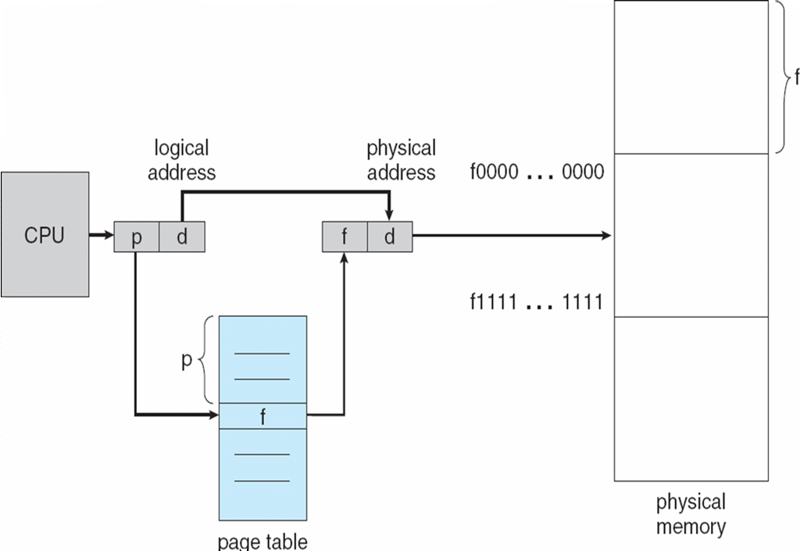
Paging Hardware
Notes:
page 轉frame + offset 經過前面的講解 一目了然 下面table圖就是第p個page擺在第f個frame

Slide 24

Paging Model of Logical and Physical Memory
Notes:
page > phy : 0>1 1>4 2>3 3>7 就轉換表 8-5 end

Slide 25

Paging Example
(0p ,2d) → 5*4 + 2 = 22
(1,3) → 6*4 + 3 = 27
32-byte memory and 4-byte pages
Notes:
page(logical mem) frame(physical mem) logic的四個英文字母 相對位置透過page table轉換 對應到physical mem

Slide 26

Free Frames
Before allocation
After allocation
Notes:
要做paging OS 要maintain那些mem位址是空free的 新的proc進來才能分配 左邊是分配前 free frame list 有橘色五格空的 資料結構可用link list或等等 新進來的程式需要4個frame 所以就挑四個給他 剩15還空的 更新free frame list 為15 隨時維護更新

Slide 27
Implementation of Page Table
Page table is kept in main memory 也是放在mem
Page-table base register (PTBR) points to the page table
Page-table length register暫存器 (PRLR) indicates size of the page table
In this scheme every data/instruction access requires two memory accesses. One for the page table and one for the data/instruction. pd去tabl查frame 轉fd再去mem查
The two memory access problem can be solved by the use of a special fast-lookup hardware cache called associative memory or translation look-aside buffers (TLBs)
Some TLBs store address-space identifiers (ASIDs) in each TLB entry – uniquely identifies each process to provide address-space protection for that process
Notes:
scheme 計畫；方案；組合，配合 要知道page table的位址 就靠 PTBR起始位址 PTLR 大小 這兩個reg所有proc共用一組即可 不用每個proc都一個 只要記錄當前執行中的proc的page tabl proc切換 reg值就跟著換 有點像context switching 兩次有點慢 怎麼更快 > fast lookup hardware cache 這叫associated mem 是給內容查位址 跟一般mem相反

Slide 28
Associative Memory
Associative memory – provides parallel search
Address translation (p, d)
If p is in associative register, get frame # out
Otherwise get frame # from page table in memory
Page #
Frame #
8
10
5
10 7
p = 6
F# = 5
Notes:
黃色table儲存最近查過的 page –frame 對應紀錄 6是內容 不是位址 所以是給內容6查到位址5 parallel search 是可以同時用6比對各個位置的資料速度很快 sequential 則是foreach比 慢 assoc找的到就直接回傳 一次 找不到再去page tabl找 2次access

Slide 29

Paging Hardware With TLB
Notes:
TLB 就是放上一頁的黃色tabl TLB左邊平行箭頭表示平行查 1 TLB hit else 2 TLB miss > page table

Slide 30
Effective Access Time
Associative Lookup = ε time unit 非常短 1 clock
Assume memory cycle time is 1 microsecond 長
步驟多 1 把addr放到addr box 然後給signal說要read data才會從data box跑出來
Hit ratio – percentage of times次數 that a page number is found in the associative registers; ratio related to number of associative registers
Hit ratio = α (0~1的值)
Effective Access Time (EAT)
EAT = (1 + ε) α + (2 + ε)(1 – α)
= 2 + ε – α
Notes:
(1/再到mem/ + ε/到associated mem/) α + (2/然後page table + 再mem / + ε/先到associated mem/)(1 – α)

Slide 31
Memory Protection
Memory protection implemented by associating protection bit with each frame
每個frame給一個protect bit
Valid-invalid bit attached to each entry in the page table:
“valid” indicates that the associated page is in the process’ logical address space, and is thus a legal page
“invalid” indicates that the page is not in the process’ logical address space

Slide 32

Valid (v) or Invalid (i) bit in a Page Table
Notes:
page table可裝8筆資料 page只有6個 所以會有兩個是沒用到的 無效的 invalid (i)

Slide 33
Shared Pages 多個proc間共用資料
Shared code
One copy of read-only (reentrant不會改自己 ex文字編輯器編輯裡面內容 程式本身的程式碼不會被修改) code shared among processes (i.e., text editors, compilers, window systems).
Reentrant code is non-self-modifying code: it never changes during execution.
Private code and data 自己用非公用
Each process keeps a separate分開的 copy of the code and data
Some operating systems implement shared memory using shared pages.

Slide 34
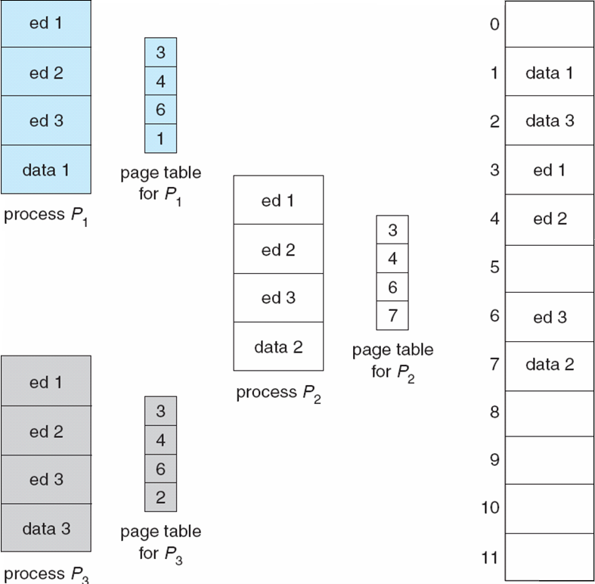
Shared Pages Example
Notes:
p1 p2 p3都在編輯檔案 這邊共用的概念可以從 最右邊記憶體三份 ed1 ed2 ed3 共用到三個proc的 各自的page table的三個page ed1 ed2 ed3為什麼可以被三個proc共用 因為他們是reentrant code 不會被修改 唯一要記錄 三個proc各自執行的位置 切換時要contxt swich 記憶體只要放一份code

Slide 35
Structure of the Page Table
Hierarchical Paging 怎麼設計
Hashed Page Tables
Inverted Page Tables

Slide 36
Hierarchical Page Tables
Modern computer systems support a large logical address space 2^{32(4GB)} to 2^{64超大}. The page table itself becomes excessively 極度地 large.
For 32-bit logical space, and page size of 4K, then a page(或frame) table caddressonsists(找不到翻譯) of 1 million entries (2³²/ 2¹² = 2²⁰ = 1 million ).
Break up the logical address space into multiple page tables 這麼大找起來慢 分兩層變小
A simple technique is a two-level page table 階層式
Notes:
4K 2^2* 2^10

Slide 37
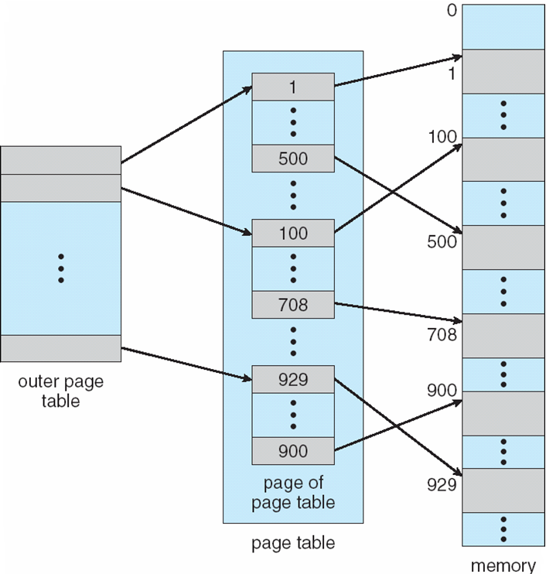
Two-Level Page-Table Scheme
Notes:
第一層 第二層 mem 一個大table拆成多個小的 再用另一個串起來

Slide 38
Two-Level Paging Example
A logical address (on 32-bit machine with 1K(10bit) page size) is divided into:
a page number consisting of 22 bits (4百萬)
a page offset consisting of 10 bits
Since the page table is paged, the page number is further divided into再拆兩層:
a 12-bit page number 4K
a 10-bit page offset 1K
Thus, a logical address is as where p₁ is an index into the outer page table, and p₂ is the displacement within the page of the outer page table
page number
page offset
p₁
p₂
d
12
10
10

Slide 39

Address-Translation Scheme
Physical memory
Notes:
ok 這樣個別table變小 但mem access次數會增加 算小缺點

Slide 40


Three-level Paging Scheme
64-bit machine with 4K page
Notes:
ok 8-8 end

Slide 41
Hashed Page Tables
Common in address spaces > 32 bits
The virtual page number is hashed into a page table
This page table contains a chain of elements hashing to the same location
Virtual page numbers are compared in this chain searching for a match
If a match is found, the corresponding physical frame is extracted
Notes:
把一個 addr 用hash function計算 得到另一個addr 算一種mapping perfect hash才是一對一 值都不同 否則可能多個對到同一個 就叫衝突 可以用link list存起來 再用linear search一個個找 比較花時間

Slide 42

Hashed Page Table
Notes:
p 要找在phy哪邊 先丟給hash f 得到值去hash tabl找 找到多個被存在link list 再找 找到r再對到phy

Slide 43
Inverted Page Table
One entry for each real page of memory
The page table is shared by all processes
Entry consists of the virtual address of the page stored in that real memory location, with information about the process that owns that page
Decreases memory needed to store each page table, but increases time needed to search the table when a page reference occurs 因為只有一個共用
Use hash table to limit the search to one — or at most a few — page-table entries
Notes:
frame(physical mem) page(logic) frame跟page 1-1對應 左有多少右就有多少 只有一個大家共用 entry紀錄frame放哪個proc的哪個page

Slide 44

Inverted Page Table Architecture
The search can be done sequentially慢, or
by hash function 有點慢, or
by associative memory 平行搜尋 快
Notes:
page table裡面entry的數量就式frame的數量 pid p > 第幾個proc的第p個page CPU 用pid p 找到放在第幾個I 就是phy的位址 因為page table 跟 mem是1-1對應
很像associa mem 給內容pid p 找出位址i 要記錄pid比較好找是哪個proc的 paging:把程式切成固定大小的page mem切成固大的frame 兩者每格大小相等 程式放在mem不避放在連續的位址

Slide 45
Segmentation
Memory-management scheme that supports user view of memory 使用者看到程式式下面列的 而非固定大小分隔
A program is a collection of segments
A segment is a logical unit such as:
main program
procedure
function
method
object
local variables, global variables
common block
stack
symbol table
arrays

Slide 46
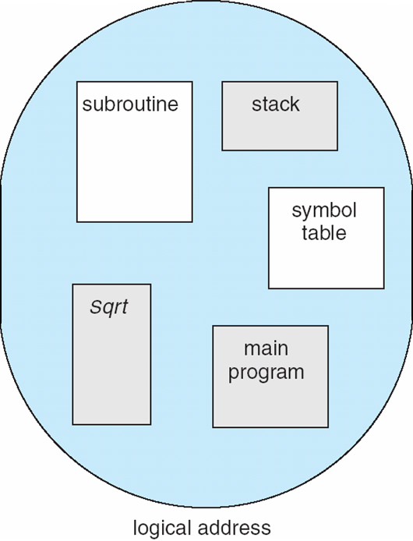
User’s View of a Program
Notes:
這才是user看到的啊! 所以記憶體不切成固定大小 就看上途中每個區塊部分功能模組

Slide 47
Logical View of Segmentation
1
1
4
2
3
4
2
3
user space
physical memory space
Notes:
右邊也不連續 且大小可變 8-8 end

Slide 48
Segmentation Architecture
Logical address consists of a two-tuple:
<segment-number, offset>,
Segment table – maps two-dimensional physical addresses; each table entry has:
base – contains the starting physical address where the segments reside in memory
limit – specifies the length of the segment(size)
Segment-table base register (STBR) points to the segment table’s location in memory 類同前面觀念
Segment-table length register (STLR) indicates指出 象徵 number of segments used by a program;
segment number s is legal if s < STLR
Notes:
Logical Addr在seg架構由 seg num, offset組成 要轉成phy addr 就也要有一個seg table去轉換 每個seg也有一個範圍base ~base+limit 保護不取到其他人的東西
每個proc都有自己的seg table 但是 STBR/LR一組就好同前

Slide 49
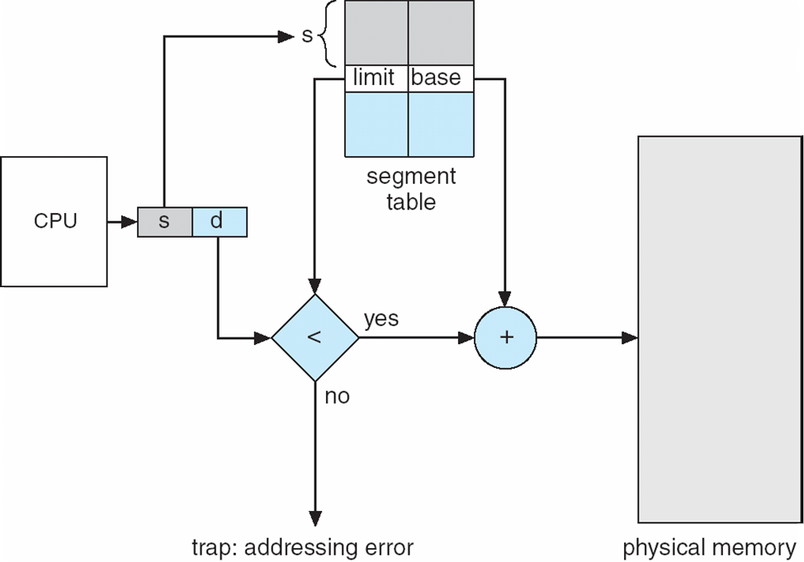
Segmentation Hardware
Notes:
s,d 查 lbase, limit 他這邊是說 有幾個segment segment table就有幾項 這有點怪是圖看起來顏色是d < limit 但是前一頁說s < limit 我覺得 s 在page是page num d是page offset 所以我覺得應該是s+d < STBR + STLR 通過就得到phy mem addr

Slide 50
Segmentation Architecture (Cont.)
Protection
With each entry in segment table associate:
validation bit = 0 ⇒ illegal segment
read/write/execute privileges
Protection bits associated with segments; code sharing occurs at segment level
Since segments vary in length, memory allocation is a dynamic storage-allocation problem ! 空間夠但是沒有連續
A segmentation example is shown in the following diagram
Notes:
8-9 都很類同前面的概念 第三點 page frame因為大小固定 所以不會有external fragmentation

Slide 51
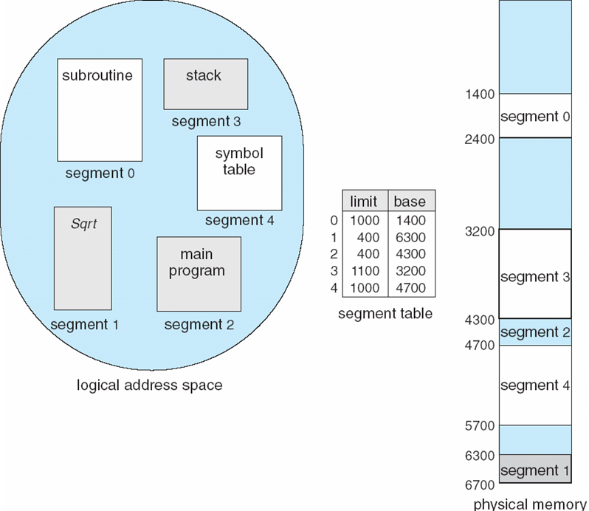
Example of Segmentation
Notes:
左邊是各功能的segment概念編號 右邊是實際mem addr 紅圈為例 l 1000 (大小) b 1400(mem起始位址) > 1400 ~ 1400 + 1000 = 1400~2400

Slide 52
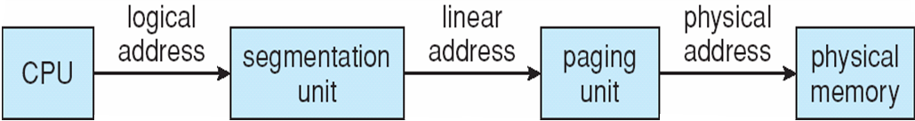
Example: The Intel Pentium
Supports both segmentation and segmentation with paging
CPU generates logical address
Given to segmentation unit 就是下面那張圖
Which produces linear addresses
Linear address given to paging unit
Which generates physical address in main memory
Paging units form equivalent of MMU
Notes:
支援seg 前面說的不管是 s, d p, d p1, p2, p3, d 從logical addr 要轉換到 physical addr 就是要靠電路 去做加的動作 也就是要依靠HW去轉換 所以這邊相當於HW只支援seg seg with page 就是seg的大小是page的整數倍 例如3 4 5 個page 下面的流程圖就是轉換seg>page>phy

Slide 53
Pentium Segmentation
A segment is allowed to be as large as 4GB (32 bits), and the maximum number of segments per process is 16K.
The logical address space is divided into two partitions:
The first partition up to 8K segments that are private to that process.
The 2nd partition up to 8K segments that are shared among all processes.
Local Descriptor Table (LDT): Information about the 1st partition
Global Descriptor Table (GDT): Information about the 2nd partition.
Each entry of LDT and GDT is an 8-byte descriptor of a particular segment. Descriptor都是8 byte
Notes:
一個程式最多可以有一萬六千個seg 一般小程式大約只用到20個 能全部用到 是很大的程式 16K裡面一半8K 8K分別pri public

Slide 54
Pentium Segmentation
The logical address is a pair (selector, offset), where the selector is a 16-bit number and offset is a 32-bit number: 16+32=48長度
The machine has six segment registers, allowing six segments to be addressed at any one time by a process. proc同時最多能抓6個seg
The linear address is 32 bits long and is formed as follows.
s g p
13 1 2
Notes:
offset 就是 seg 的size大小 32 bit代表一個seg最大能4GB

Slide 55
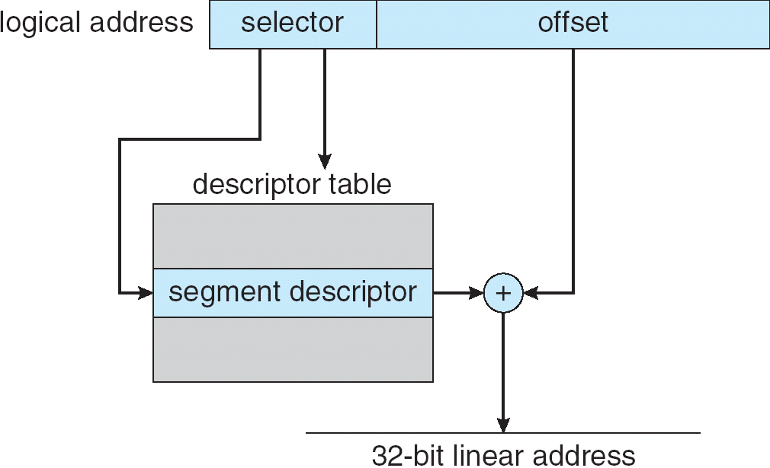
Intel Pentium Segmentation
16 32
8
Notes:
這邊不全完清楚為什麼selector16 去8 byte的descriptor查 但流程就是 selector >去descr查 然後加上offset 就變成32 bit linear addr 後面再透過paging unit轉phy

Slide 56
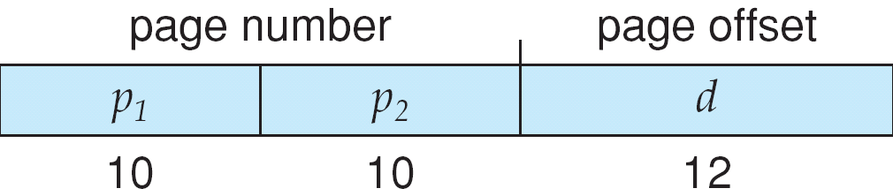
Pentium Paging
A page is allowed to be as 4kB or 4MB.
For 4-KB pages, a two level paging scheme is used (32-bit linear address)
The address-translation scheme is shown as follows.
Page directory
Page size flag
Notes:
4KB > 2^12 所以藍條 最右邊12 左邊2^10 10 = 1000 1000 = 一百萬

Slide 57
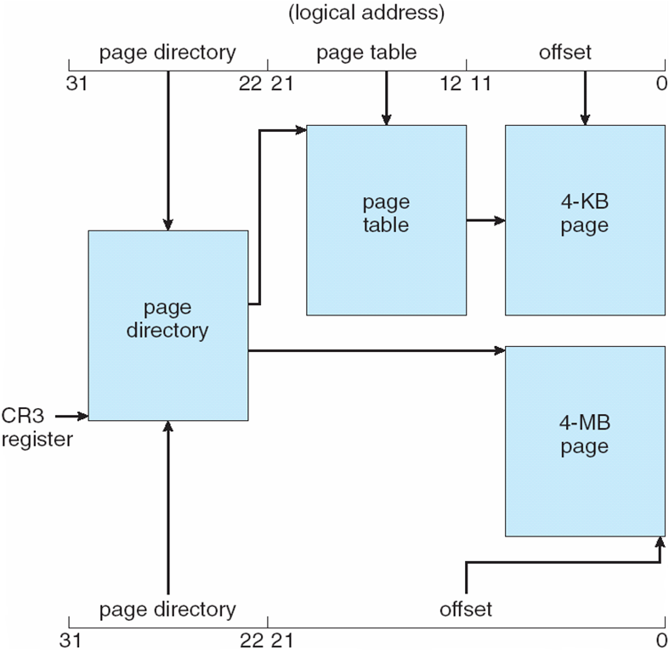
Pentium Paging Architecture
Notes:
page dir就是前面的p1 page table就是p2 加上offset 4KB是走 p1 p2 offset 4MB因為x1000 = 10bit 所以佔掉中間的10bit 只要跟page dir > offset 就行

Slide 58
Linux on Pentium Systems
Linux does not reply on segmentations and used it minimally.
On the Pentium, Linux uses only six segments只用了6 :
A segment for kernel code
A segment for kernel data
A segment for user code
A segment for user data
A task-state segment (TSS)
A default LDT segment
Notes:
前面是硬體 硬體上面可以跑各種OS linux xp windows solaris … OS怎麼用硬體 就看OS了 硬體有提供 OS不一定用 Linux 沒有用 seg page 只有用seg
前面說intel pentium 可以讓一個proc有16K個seg 但linux只需要6個 LDT Local Descriptor Table

Slide 59

Linear Address in Linux
The linear address in Linux is broken into four parts:四階
Each task in Linux has its own set of page tables and the CR3 register points to the global directory for the task currently executing. CR3指向正在跑
During a context switch, the value of CR3 register is restored in the TSS segments of the tasks involved in the context switch.
Notes:
task-state segment (TSS)

Slide 60
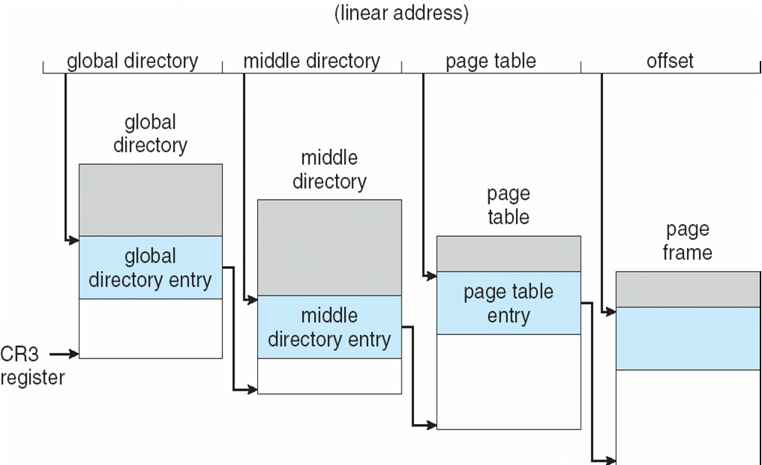
Three-level Paging in Linux
Physical memory
Notes:
page table裡面是記第幾個frame frame number要再乘上size 才是起始位置 + offset 才是真正的記憶體位置

Slide 61
End of Chapter 8

